Slide 1
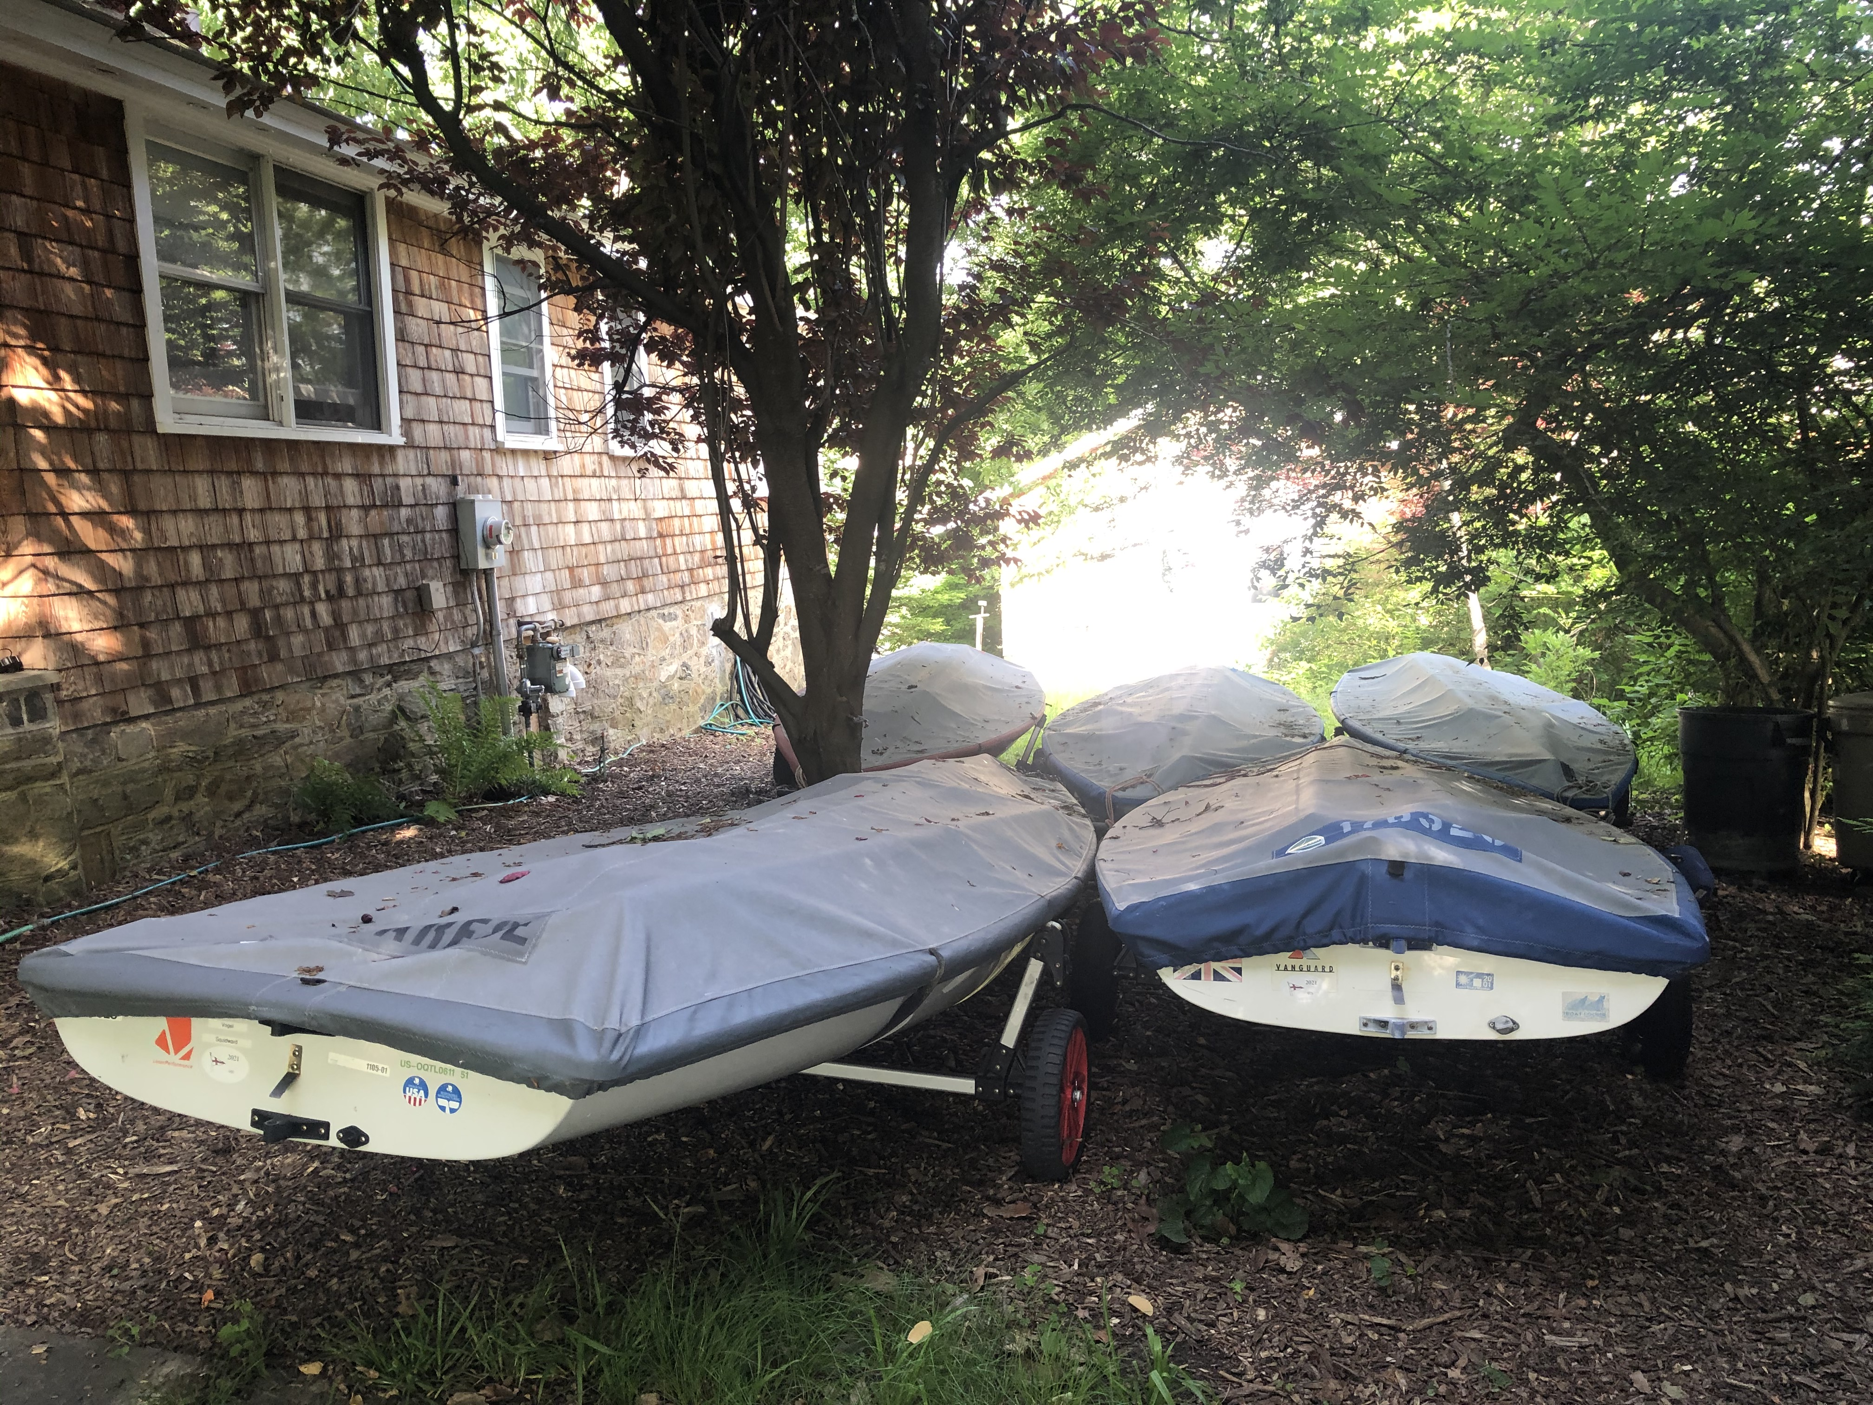

Slide 2
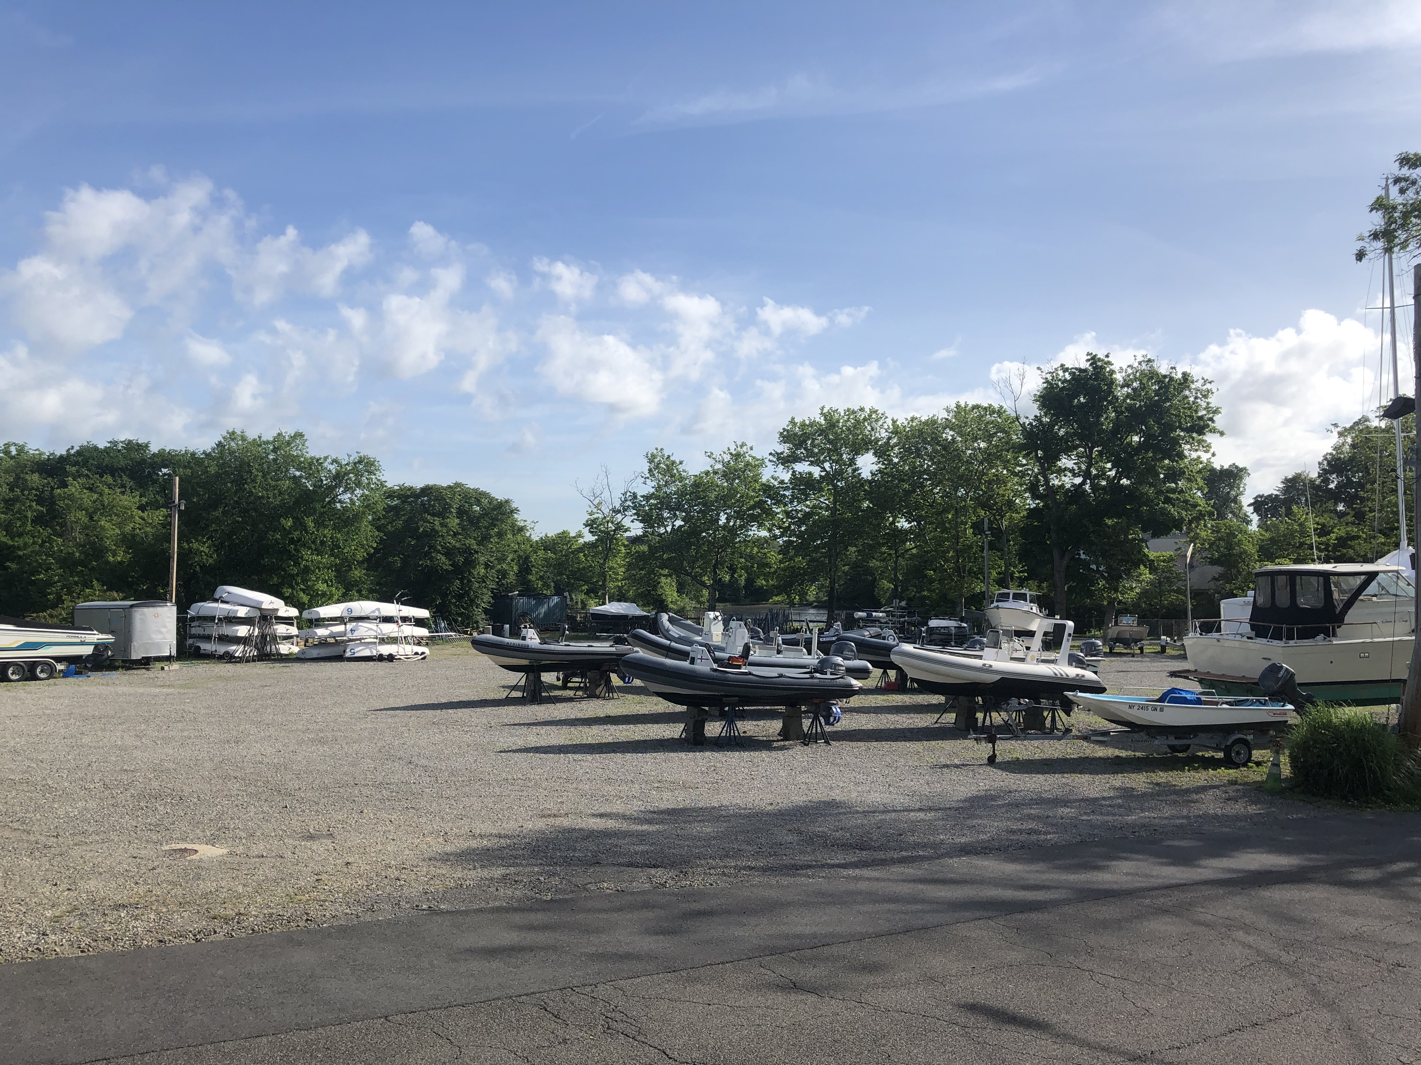

Slide 3
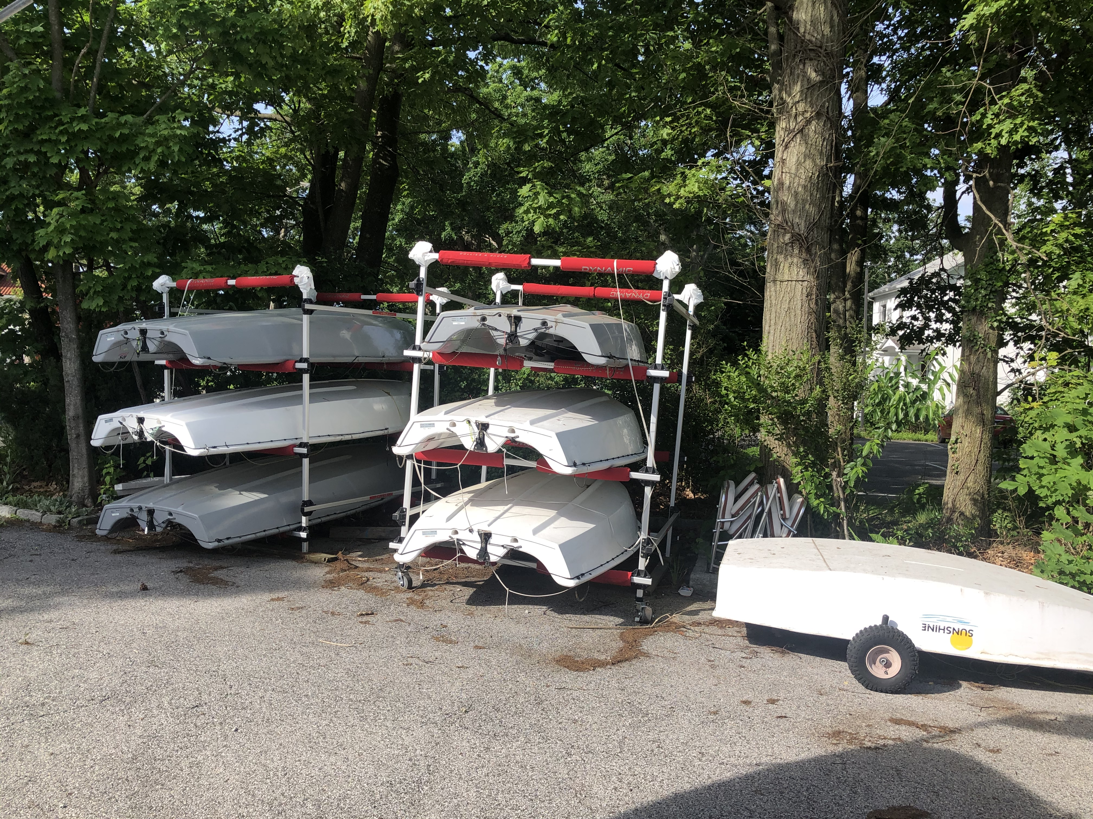

Slide 4
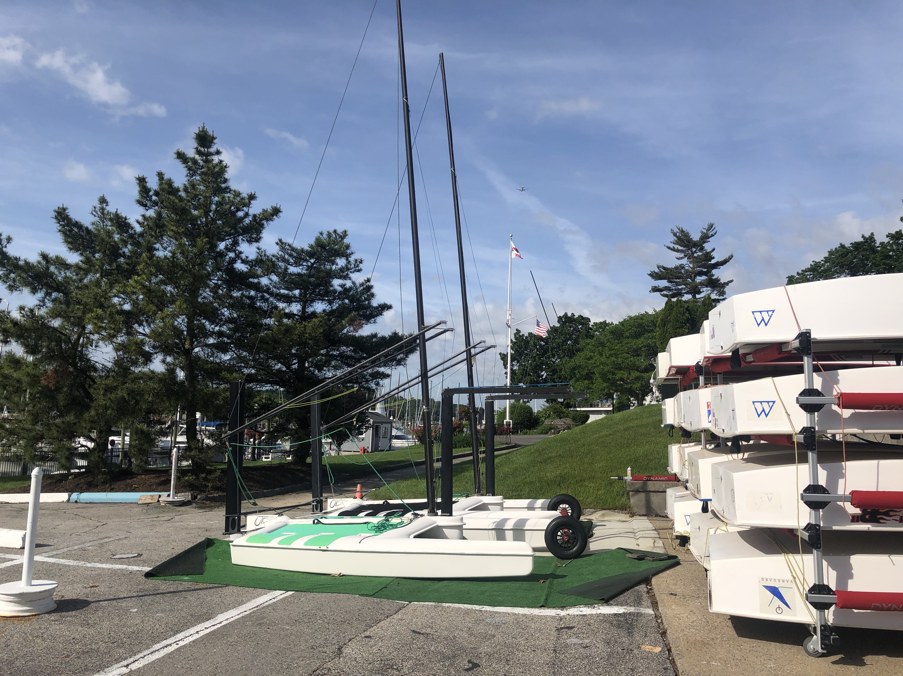

Slide 5
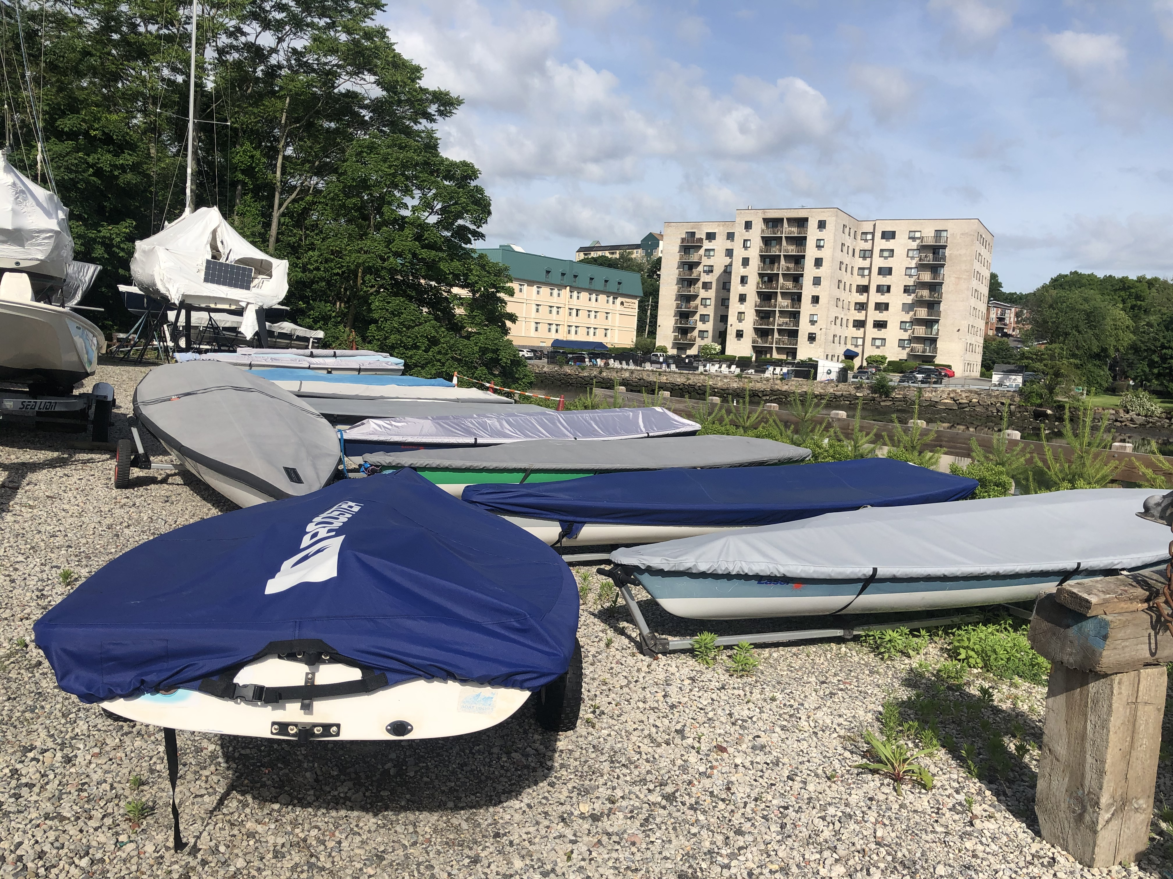

Slide 6
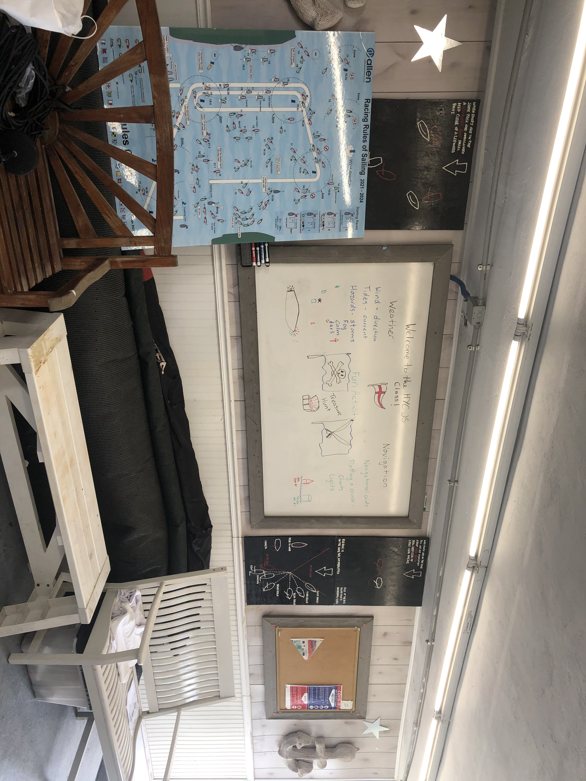

Slide 7
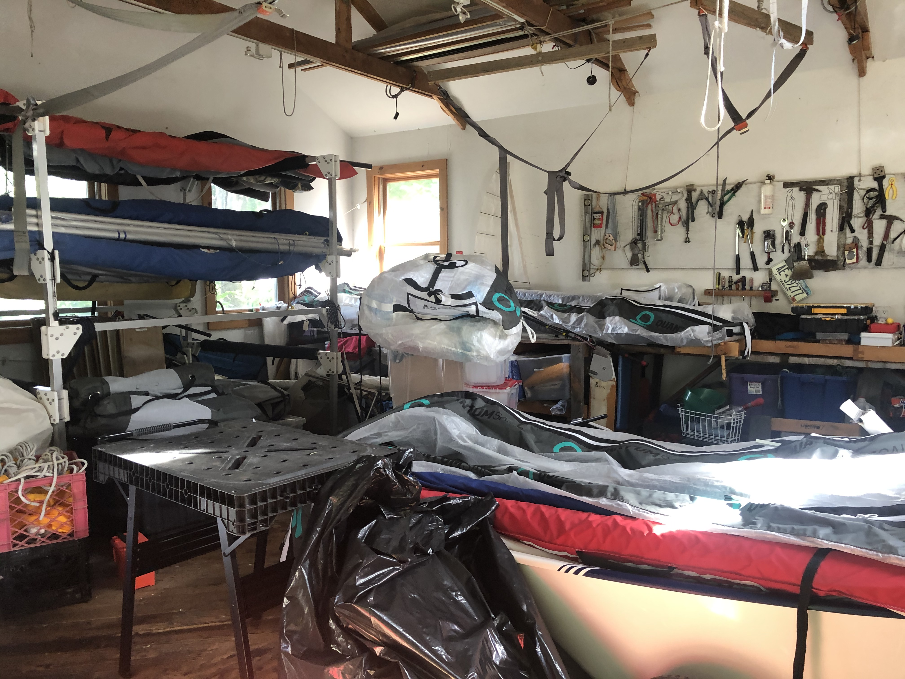

Slide 8
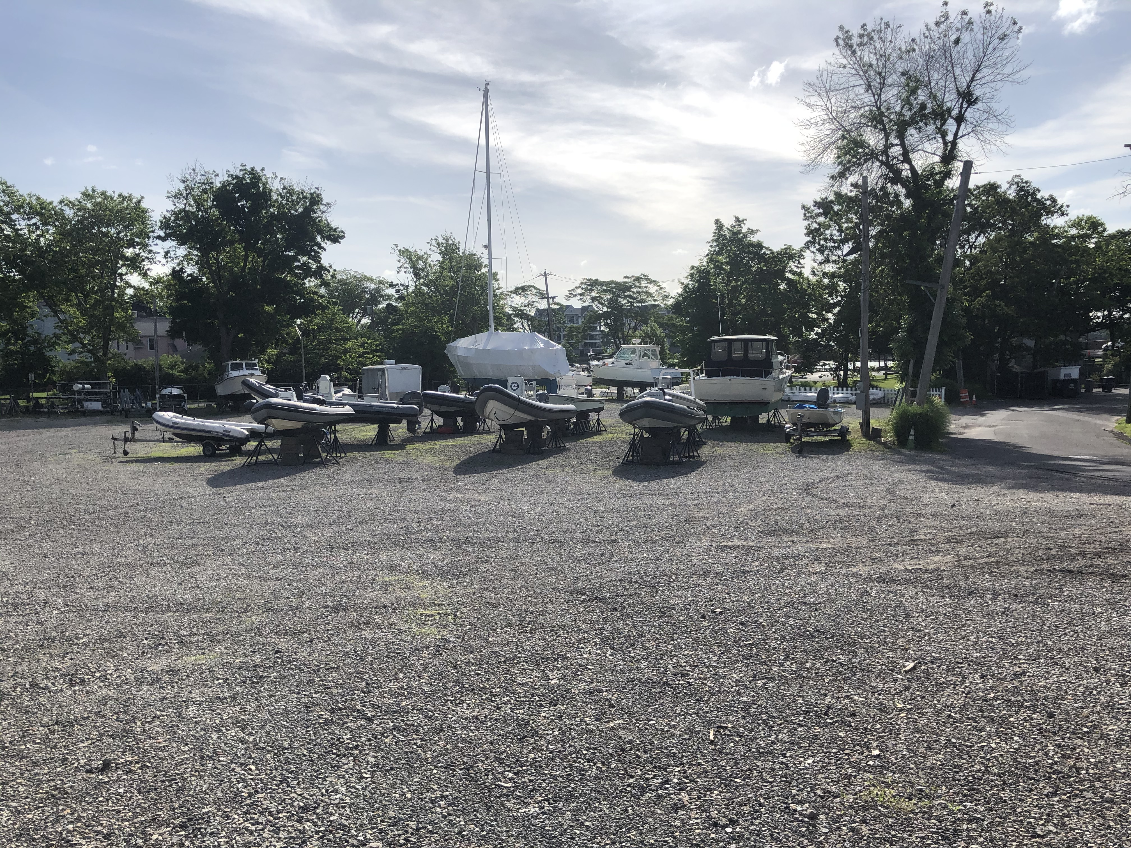

Slide 9
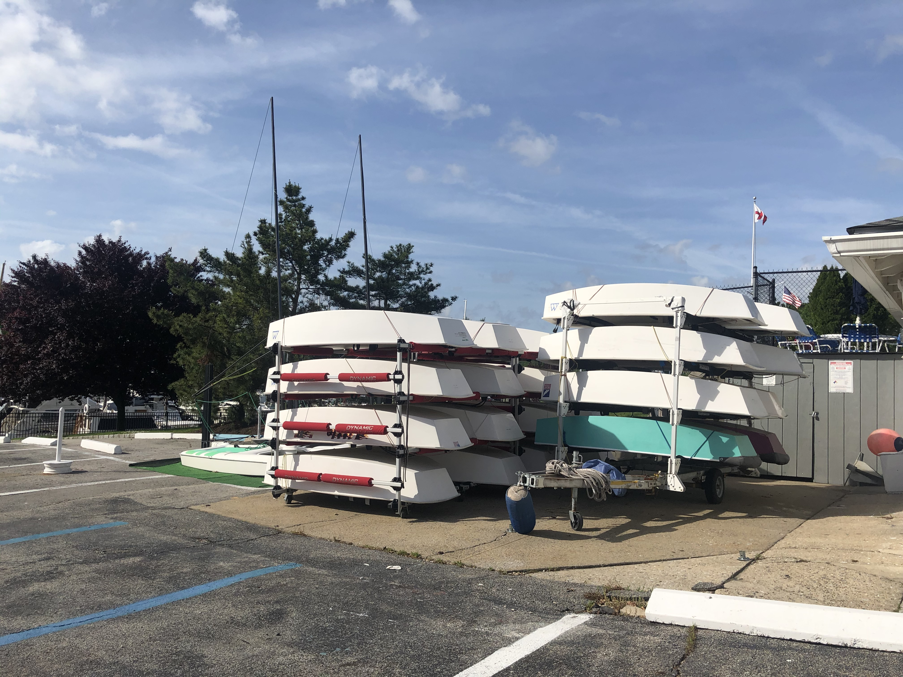

Slide 10
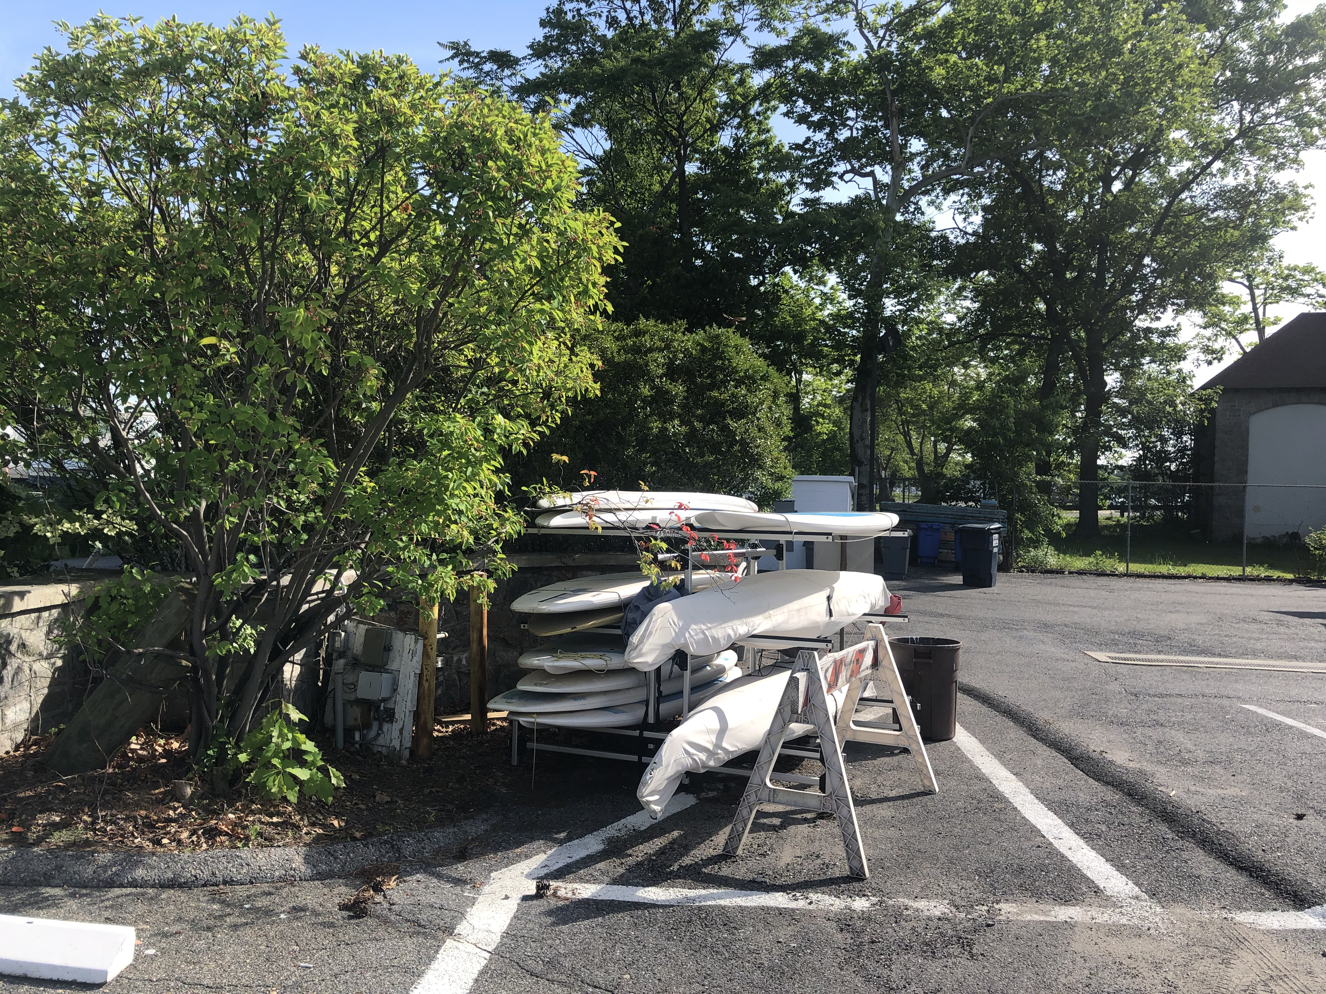

Slide 11
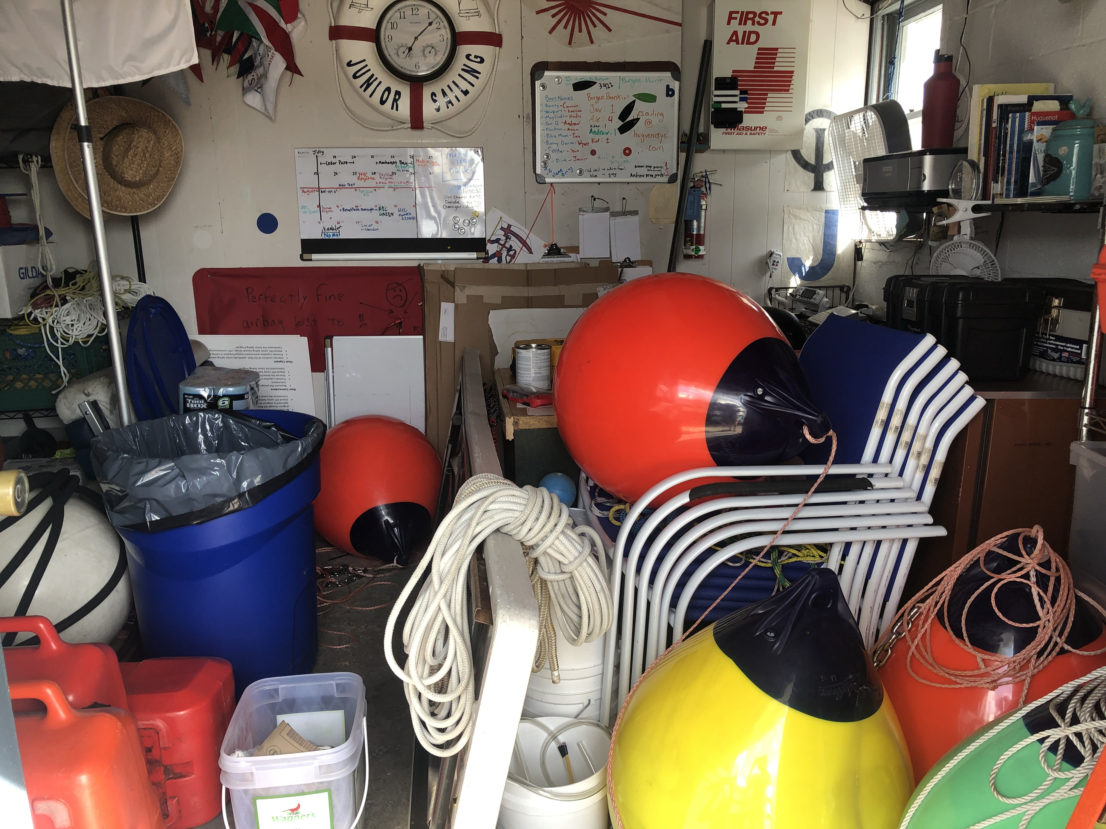

Slide 12
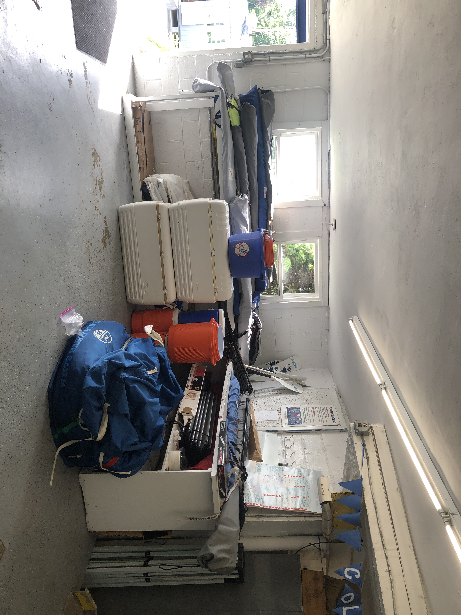

Slide 13
HYC Junior Sailing 2022
Safety – Fun – Learning
Our mission is to provide the best sailing instruction in a safe, fun environment

Slide 14
HYC will follow all CDC and NYS Health Guidelines. There may be changes and updates
No face coverings are required
No indoor activities
Safety

Slide 15
Limit on launches: 6 sailors
Small groups stay together
All sailors arrival and pickup times:
9 am - 4 pm
Each sailor has their own boat

Slide 16
Feva sailors team up and stay together
Lunch: Pre-packaged, regular or vegetarian
Small groups
Pool: After lunch, other club members may be using the pool

Slide 17
Do not send sailors if they don’t feel well, call the office at (914) 636-6300 if your child is not attending
Anyone with a temperature higher than 100 F will be sent home
Other safety measures: All coaches are CPR/First Aid certified.
If your child receives treatment for minor scrapes and injuries, you will be notified

Slide 18
The HYC safety plan is available on our website
In case of inclement weather, including named storms, the program may be cancelled for the day
We have a zero tolerance policy for bullying.

Slide 19
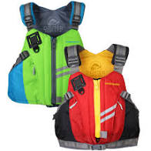
Life Jacket
What to bring
Coast Guard approved type III
Available at www.landfallnavigation.com

Slide 20
Water bottle
Lotion applied at home
Extra lotion for after lunch (no aerosol)
Towel and bathing suit
Ice cream money
Hat
Sunglasses
Closed toe shoes (water shoes, crocks, sneakers)
All personal items have to be labeled

Slide 21
No cell phones are allowed on the water.
If parents need to get in touch with their children,
call the office at (914)636-6300
Final payments are due before a child can attend
The program

Slide 22
What’s new this summer:
New coach boats
Foiling intro
Melges 15
Junior Sailing Commissioning
Friday, June 24th 3-5 pm

Slide 23
Typical Day:
Arrive at 9 am
Meet your instructor and group
Chalk talk
Rig boat
Go sailing
Lunch
Pool time
Afternoon sail
Debrief
Ice cream

Slide 24
Thank you!
Commodore Tom Barnard
JS Committee
Laurent Bannon Brendan Carobene
Jacki and Bill Morris Alicia Cerwinsky
Bill Heintz Iris Vogel
Bengt Johansson
PC Larry Rouen
Kathryn Ahitow
Maureen Coughlin
Kate Menz
Anne Dangy
John Ferrante

Slide 25
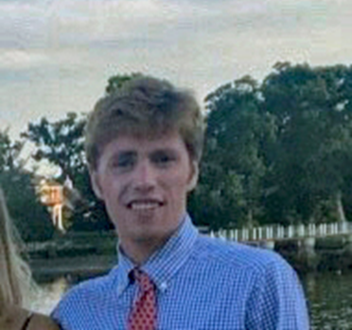
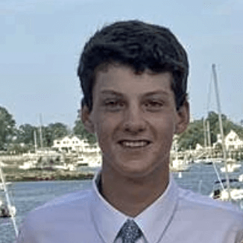
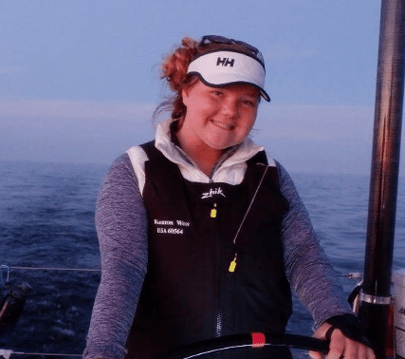
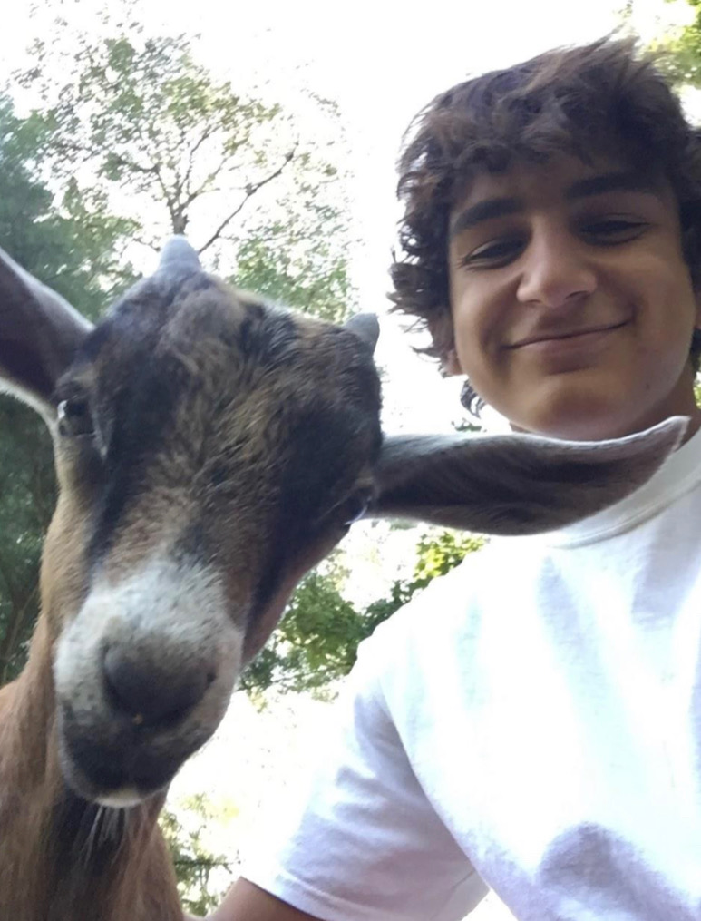
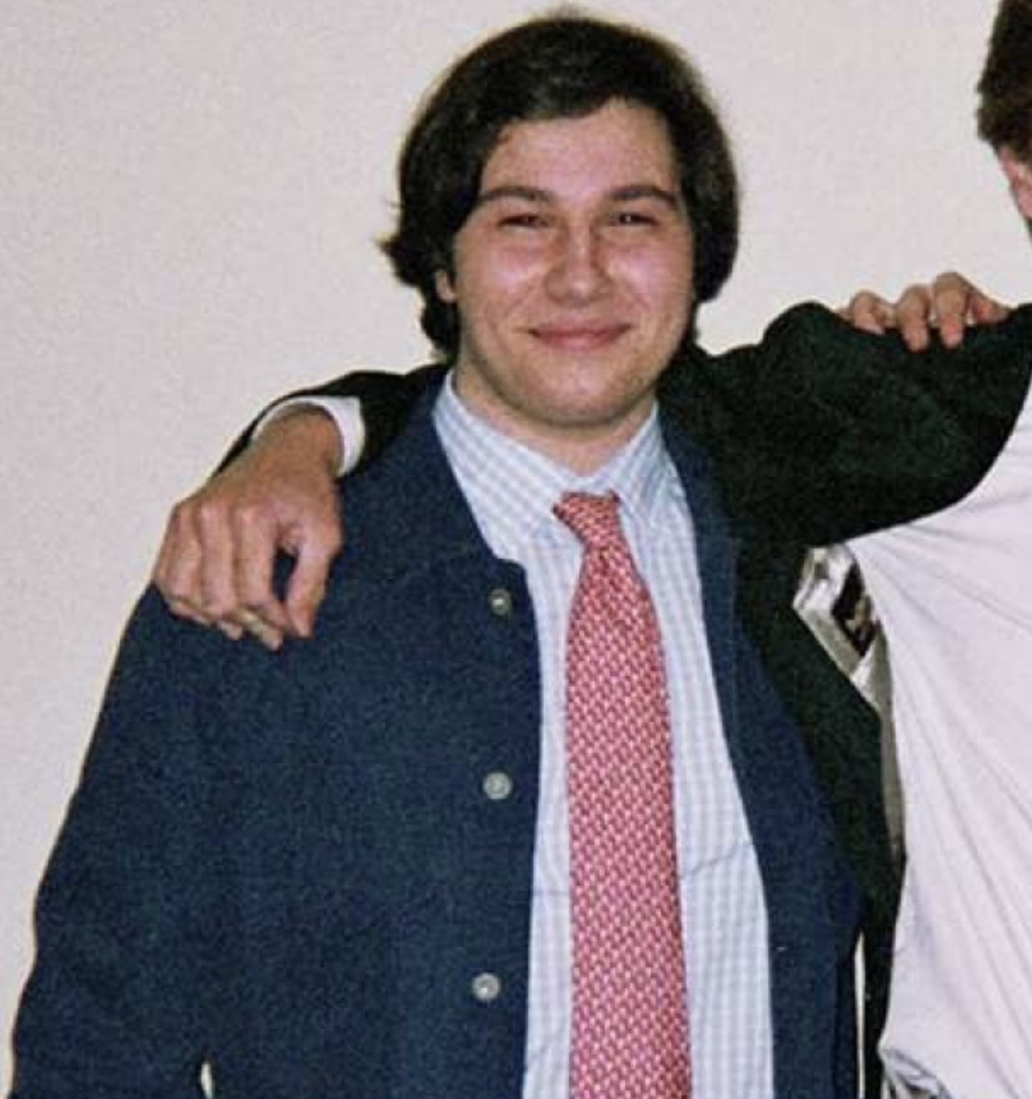
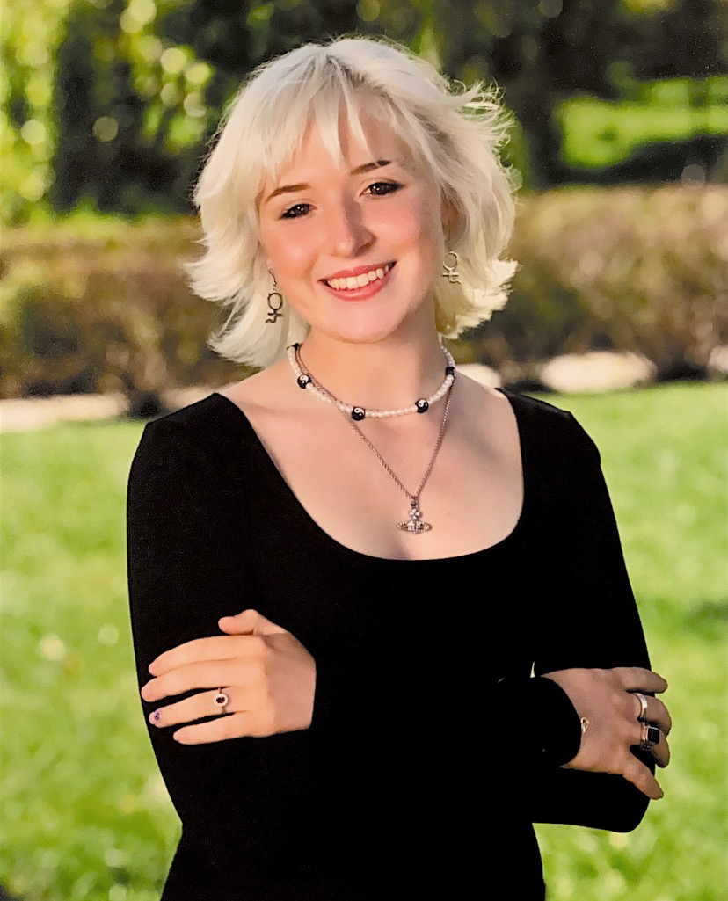
Looking forward to a great summer
Tillie Morris
Sailing Director
Iain Macintyre
Head Instructor
Connor Robinson
Sailing Coach
Katrina Ronan
Sailing Instructor
Alejandro Amezcua
Sailing Instructor
Wyatt Bischoff
Race Coach
Young Hu
Sailing Instructor
Morgan Robinson
Sailing Instructor
Nick Murphy
Admin
Andrew Cipriani
Sailing Instructor
Fae Campbell
Sailing Instructor

