Slide 1
HYC Junior Sailing 2021
Safety – Fun - Learning

Slide 2
HYC will follow all CDC and NYS Health Guidelines. There may be changes and updates
No face coverings required
No indoor activities
Safety

Slide 3
Limit on launches: 6 sailors
Small groups stay together
All sailors arrival and pickup times:
9 am - 4 pm
Each sailor has their own boat

Slide 4
Feva sailors team up and stay together
Lunch: No restrictions, pre-packaged, regular or vegetarian
Small groups
Pool: no restrictions

Slide 5
All staff and sailors get a temperature check upon arrival
Anyone with a temperature higher than 100 F will be sent home
Health self assessment: do not send sailors if they don’t feel well

Slide 6
The HYC safety plan is available on our website
In case of inclement weather, the program may be cancelled for the day
We have a zero tolerance policy for bullying.

Slide 7
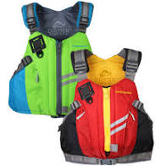
Life Jacket
What to bring
Coast Guard approved type III
Available at www.landfallnavigation.com

Slide 8
Water bottle
Lotion applied at home
Extra lotion for after lunch (no aerosol)
Towel and bathing suit
Ice cream money
Hat
Sunglasses
Closed toe shoes (water shoes, crocks, sneakers)

Slide 9
No cell phones are allowed on the water.
If parents need to get in touch with their children,
call the office at (914)636-3048
Final payments are due before a child can attend
The program

Slide 10
What’s new this summer:
Sonar keelboat sailing
29er intro
More paddleboards
Feva team racing
Junior Flag
Scouts sailing merit badge
Skill up
Big boat day is back

Slide 11
Typical Day:
Arrive at 9 am
Meet your instructor and group
Chalk talk
Rig boat
Go sailing
Lunch
Pool time
Afternoon sail
Debrief
Ice cream

Slide 12
Thank you!
Commodore - Jeff Krosche
JS Committee
Co-Chair - Michael Cassidy
Co-Chair - Iris Vogel
Bill Heintz
Jacki and Bill Morris
Bengt Johansson
PC Larry Rouen
Kathryn Ahitow
Serge Leonidov
Maureen and Dave Coughlin
Ean Pratt
Berkai Baikal

Slide 13
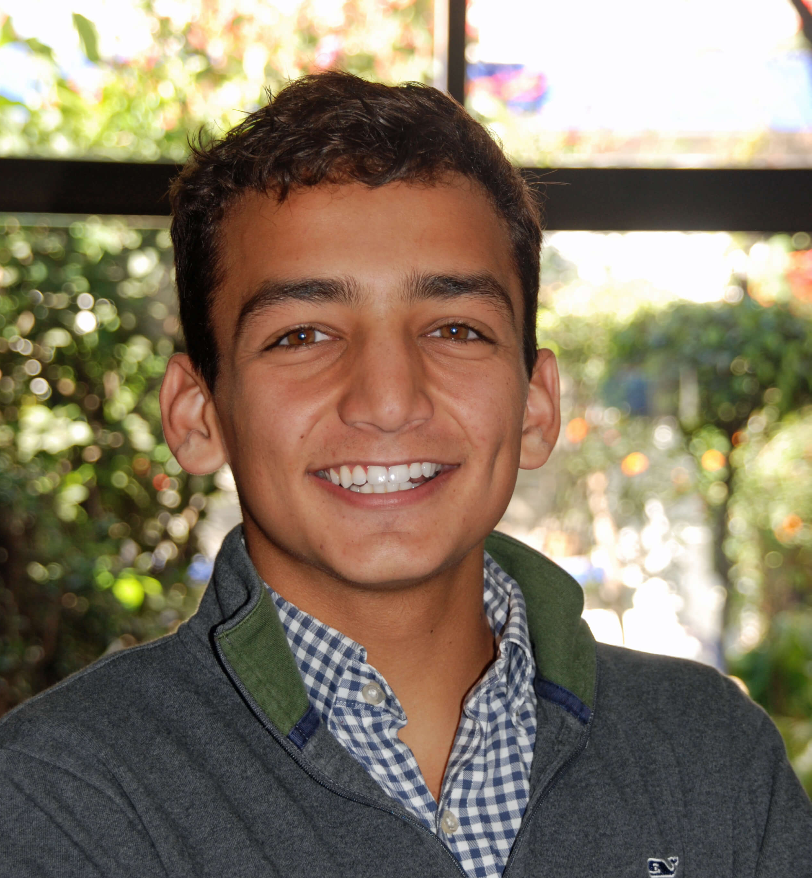
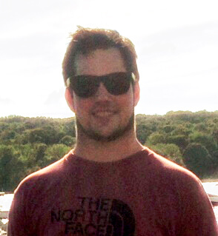
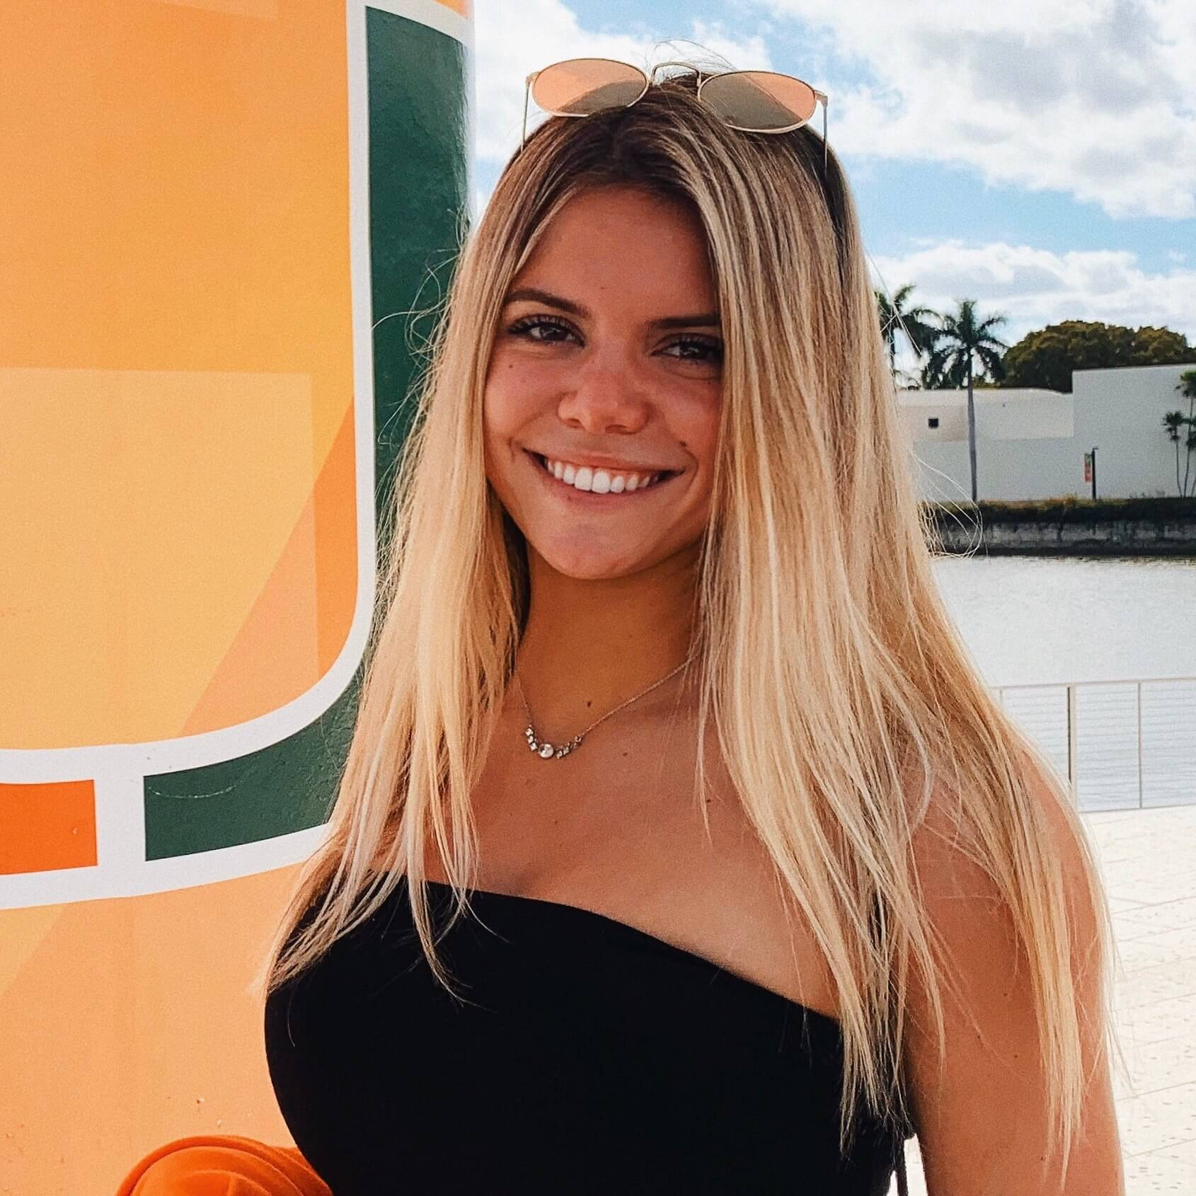
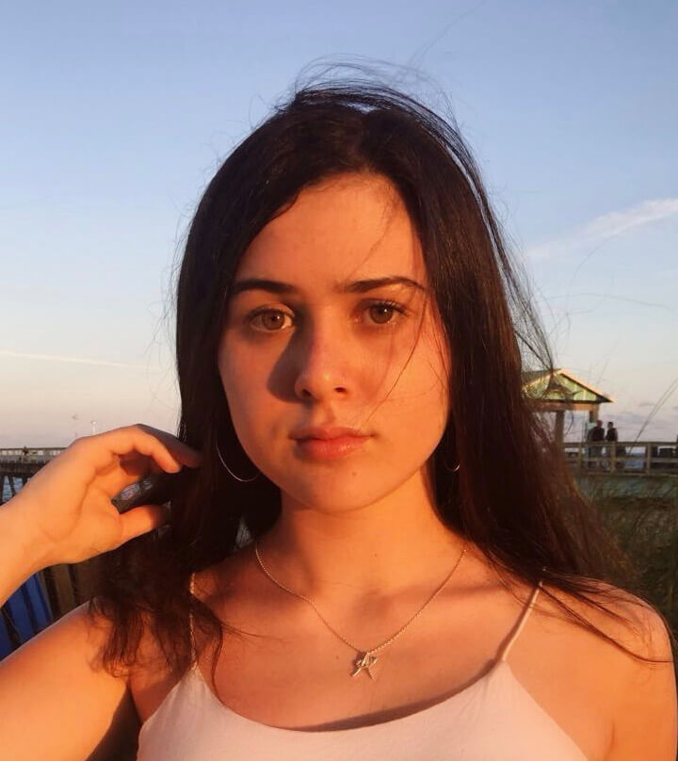
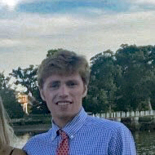
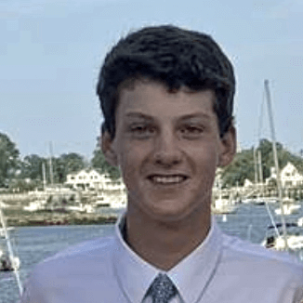
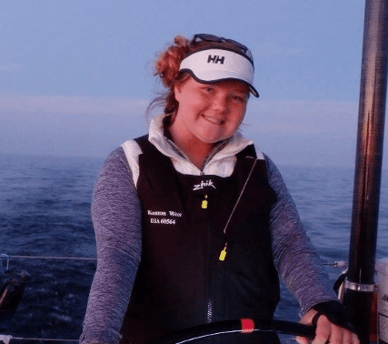
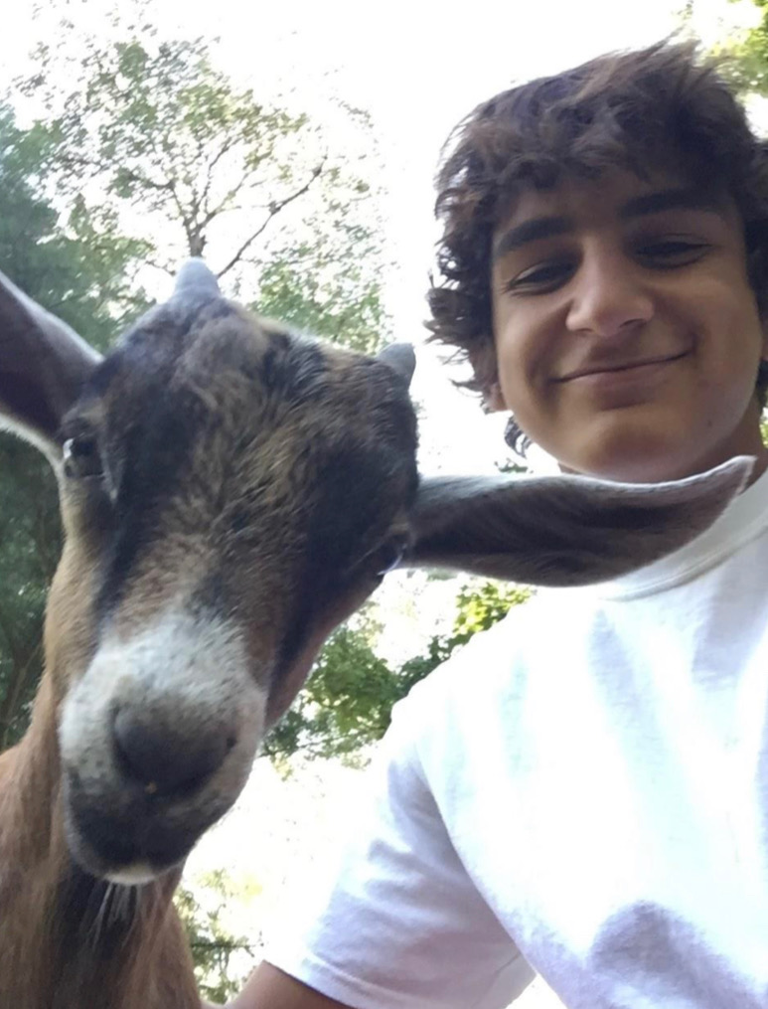
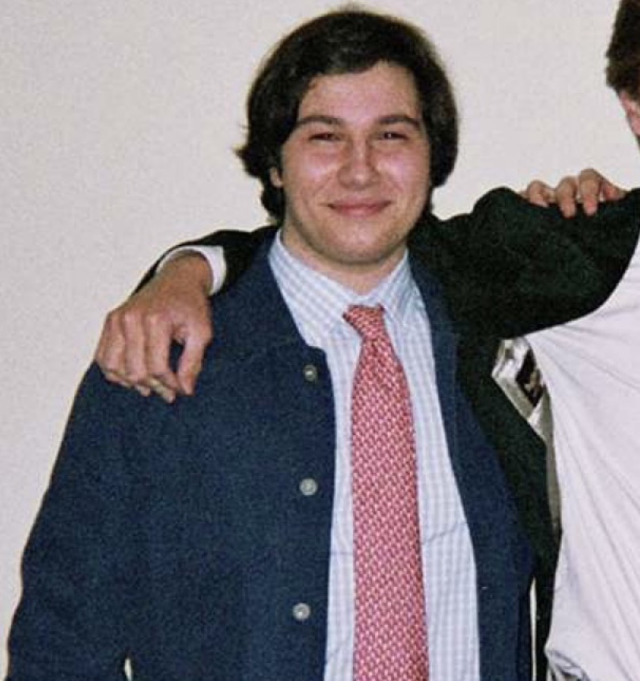
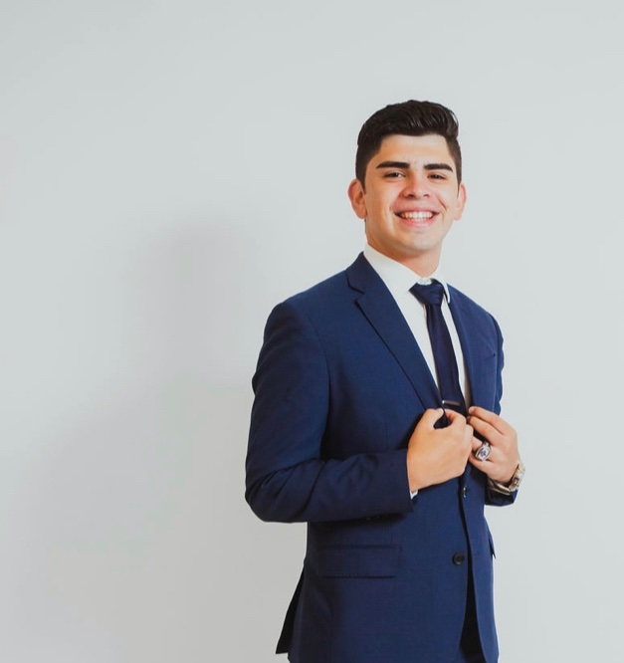
Looking forward to a great summer
Javier Amezcua
Sailing Director
Brendan Boyle
Race Coach
Christina Livaccari
Head Instructor
Anna Castellitto
Sailing Instructor
Iain Macintyre
Sailing Coach
Connor Robinson
Sailing Coach
Katrina Ronan
Sailing Instructor
Alejandro Amezcua
Sailing Instructor
Andrew Cipriani
Sailing Instructor
Moi Reyes
Admin

